Slide 1
CAPSTONE PROJECT on car Accident Severity by GVG

Slide 2
Contents
Background
Data Understanding
Methodology
Results and Discussion
Conclusion

Slide 3
Background
Vehicles may be car, trucks, etc., .
accidents may happen at different latitudes and longitudes.we have to find those based on city or province.
Severity code and its description specifies the situation of the victim.
victim vehicle and how many victims affected gives us how many are under that severity.

Slide 4
Data Understanding
Load file
Display categorical features
Inspect the features like Accident_Severity, Speed_Limit,etc.,
Most accidents occur at low speed limits but they are more severe in proportion at higher speed limits (makes sense)
Weather, road surface and light conditions
Most accidents occur in normal weather, only Fog or High winds increase the proportion of severe accidents
Junctions types

Slide 5
Methodology
Initially, I thought that Our data is now ready to be fed into machine learning models.
No algorithm is suitable to do predictions as described below.
First we imported the data through read_csv(). I noticed that it had 194,674 rows and 38 columns. Therefore, we narrowed it down to 9 columns (‘Severity’, ‘X’, ‘Y’, ‘Location’, 'Vehcount’, ‘Weather’, ‘Roadcond’, ‘Lighdcond’ and ‘Hitparkedcar’) and delete the missing values, which made the final dataset with 184,167 observations and 9 variables.

Slide 6
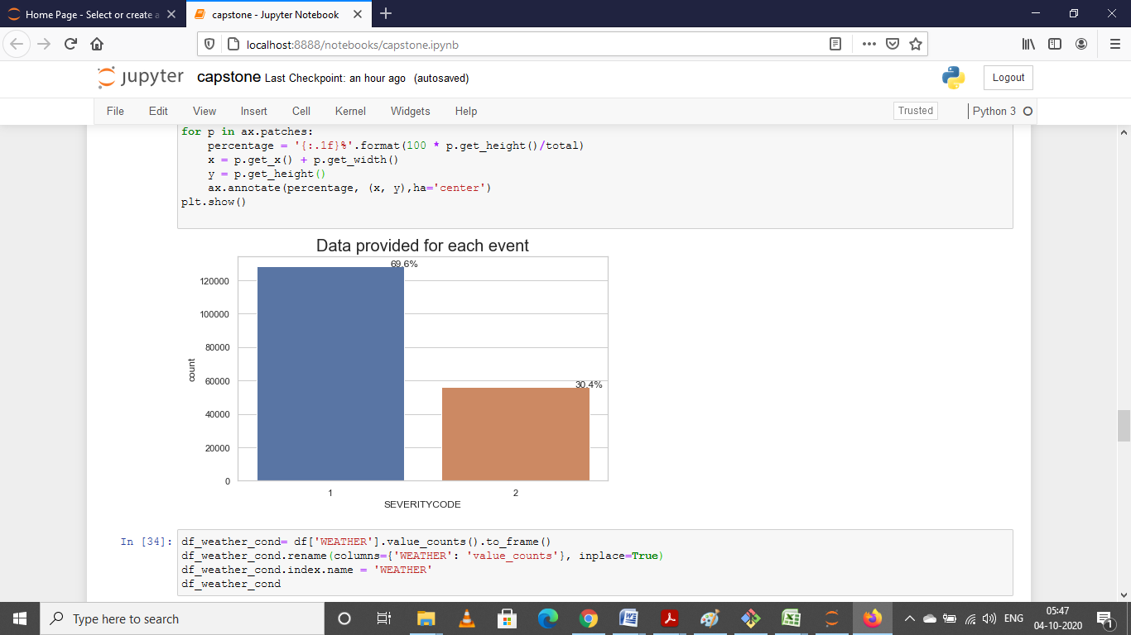
Methodology
Since most of the variable were categorical, it was hard to make the regression model. So, in this study, we focused more on the graphical data and the value count for different categories. There were around 69.6% (2/3) level 1 accidents and 30.4% (1/3) level 2 accidents.

Slide 7
Results and Discussion
We generated the graphical information based on Seaborn library. The result showed that some locations did have more car accidents than the other places.
After that, we checked about the weather, road, and light condition. We calculated the total number of car accidents under different situations. There was no significant evidence showed that they might be the reason for the accidents.

Slide 8
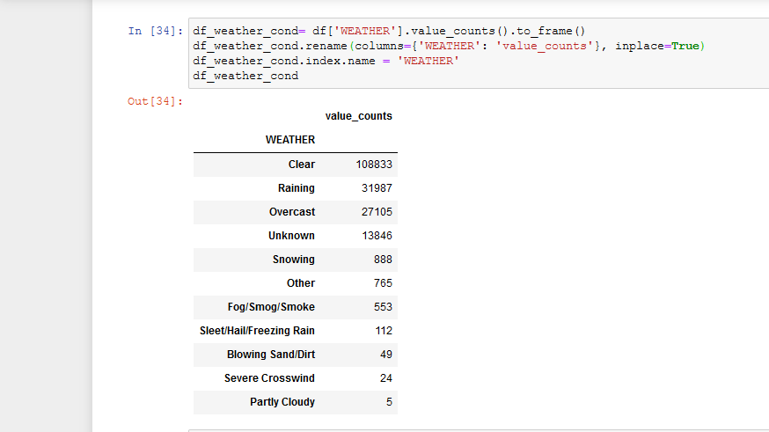
Results and Discussion

Slide 9
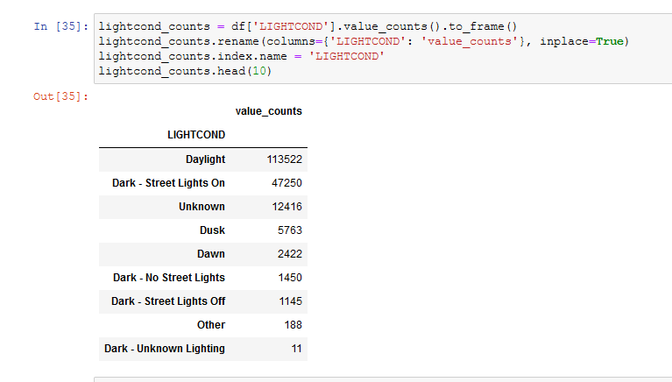
Results and Discussion

Slide 10
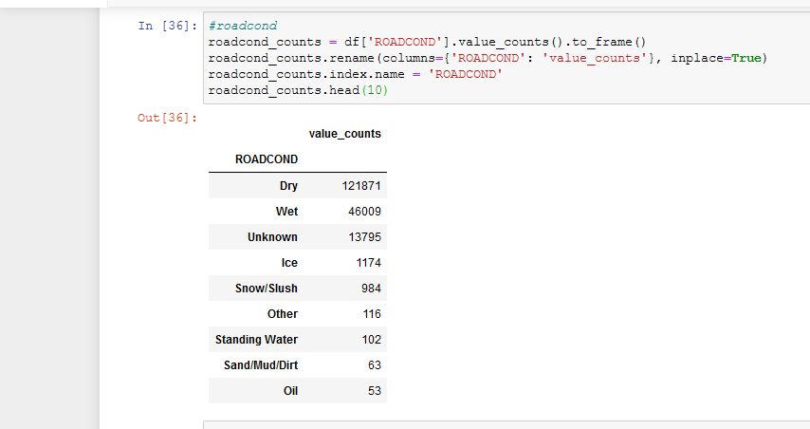
Results and Discussion

Slide 11
Conclusion
Besides, there are a few spots which has more mishaps during the dull time(more information might be given ). For those spots, including lights may be a decent answer for decrease the crashes. Additionally, when more vehicles engaged with the mishap, it appears to be that the degree of seriousness will increment. They may should be reacted quickly to spare life and wards.

